Slide 1
Entrepreneurial Finance
Financing Ventures

Slide 2
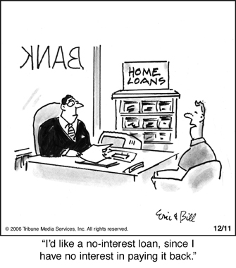
Problems when financing Start-Ups
No comparative information
Management and their skills unknown
Asymmetric information
  Forecasts
  Financials
  Often no track records
  Valuing intellectual property is difficult
  No comparative information
No business skills
“Reliability of Newness”

Slide 3
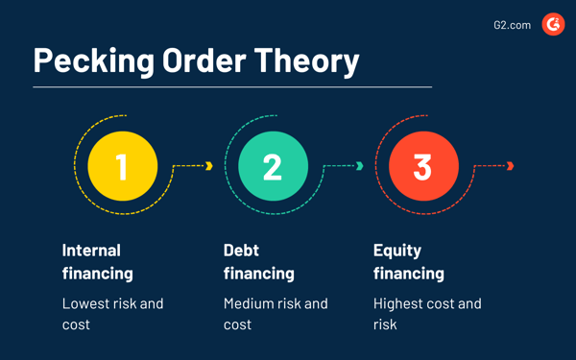
The Pecking order theory: Sources of Capital

Slide 4
What’s the signal of issuing debt or equity to an investor?
Imagine that you are in need of capital for your new business idea.
  Would you rather offer debt or equity to an investor?
  What does it depend on?
  Why?
As an investor, would you rather give out a loan (debt) or buy shares of a new company?
  What does it depend on?
  Why?

Slide 5
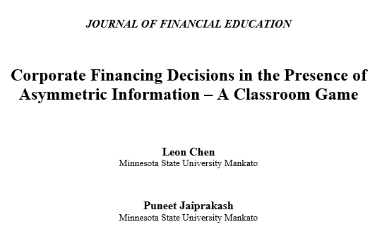
Let’s play a game…
For this game, you are assigned either an Investor or an Entrepreneur
Your Goal is to maximize your profit!

Slide 6
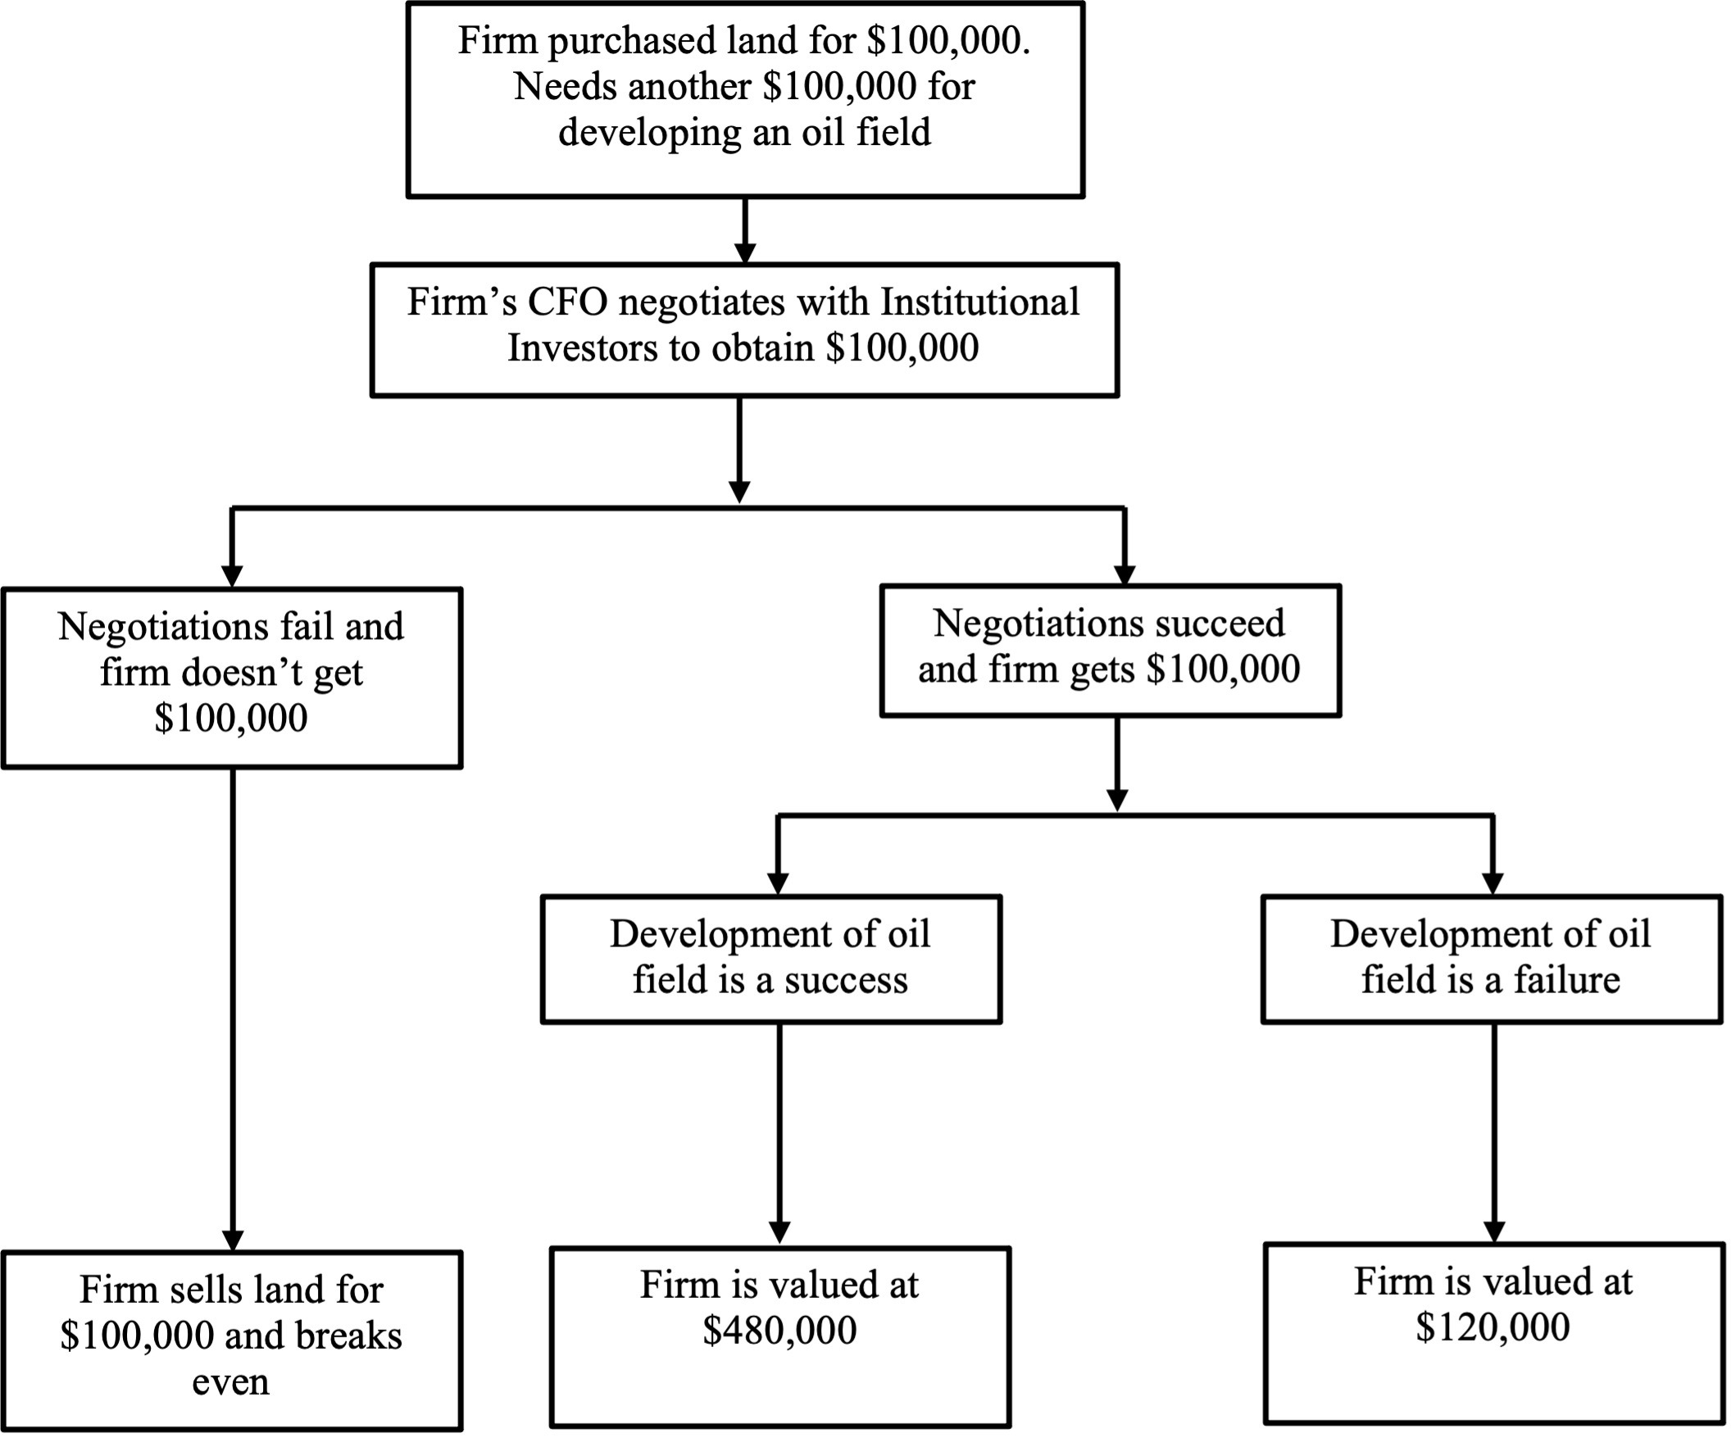

Decision in the presence of Asymmetric Information

Slide 7
Preparation Phase
Investor & Entrepreneur Assignment
3-4 Investors (Solo or Group)
Up to 12 Entrepreneurs
Read the handout for your role (Investor or Firm)

Slide 8
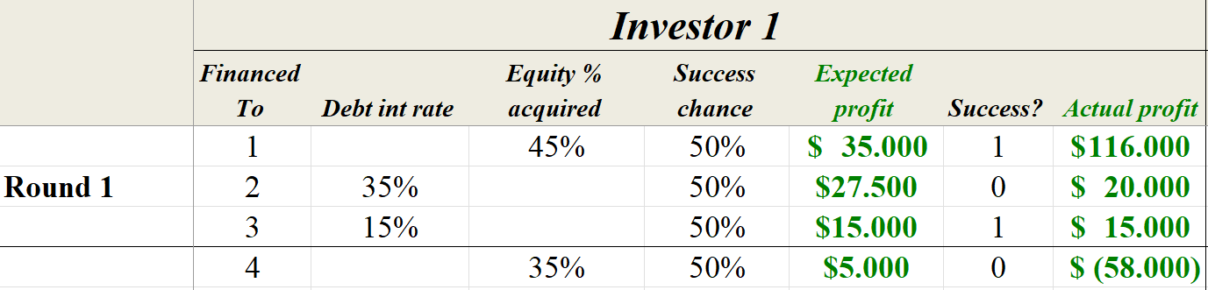
Some Math is needed: Investor perspective
4 Investments were made under different conditions. 2 with equity and 2 with debt.
What are the expected and actual profits/losses from the Entrepreneurs 1,2,3,4?
Notes:
$ 164.000
$ (100.000)
$ 265.000
$ (22.000)

Slide 9
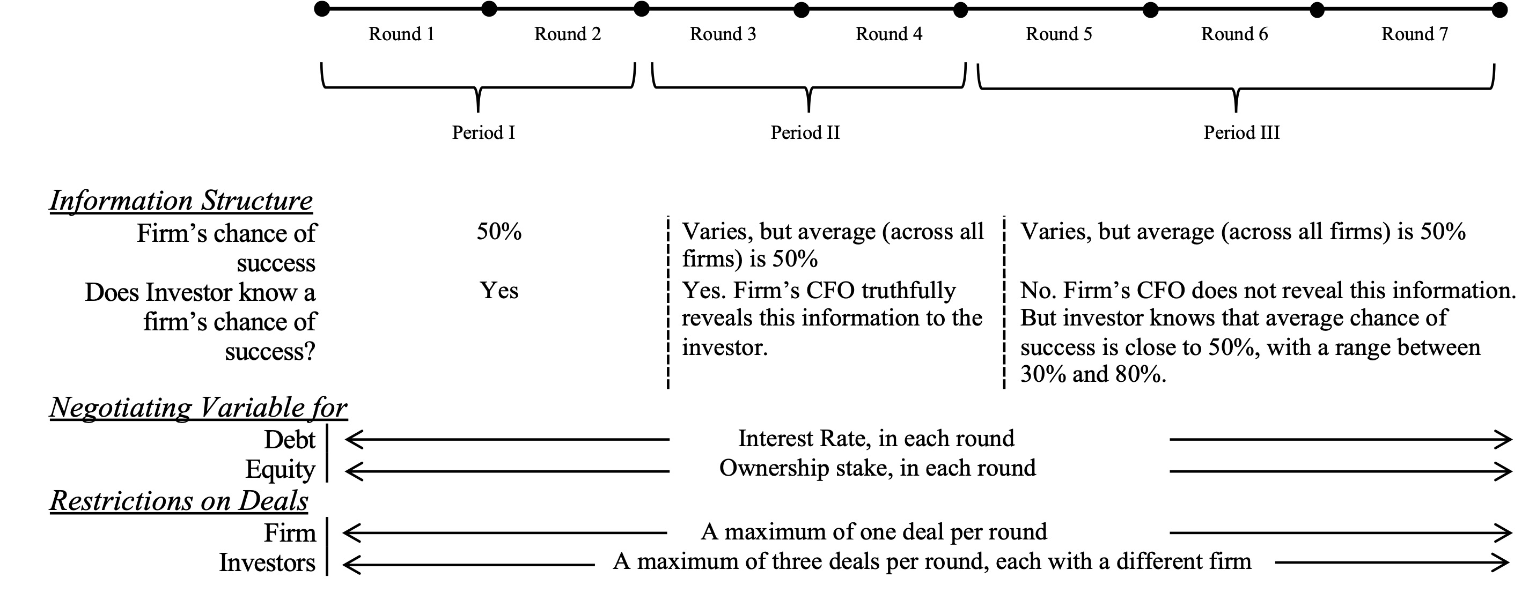
Setup of the Game

Slide 10
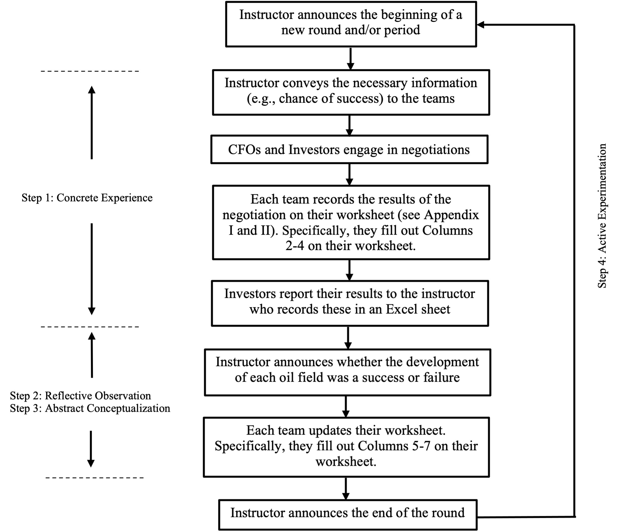
Structure of the Game

Slide 11
Decision in the presence of Asymmetric Information
RULES of the Game:
1. The game has three periods, and multiple rounds in each period. The instructor will announce when each round starts and ends, and will also announce whether each oil field is success or failure after each round, using a result drawing with the given probability.
2. During Period I, all entrepreneurs will have a 50% chance of success.
3. During Period II, each entrepreneur will have a different assigned probability of success, and each needs to truthfully reveal that probability information to the investor.
4. During Period III, each entrepreneur will also have a different assigned probability of success, but you, as an investor, do NOT know that information (i.e., entrepreneurs do NOT need to reveal that probability information to you). But what you know is that the average chance of success for the whole group of entrepreneurs is close to 50%, with a possible range between 30% and 80%.
5. You MUST report the transaction details to the instructor whenever a round is finished.
6. You can make a maximum number of 3 deals in each round with different (not the same) entrepreneurs, through negotiations with the entrepreneurs, but you are NOT required to make any deals in each round.

Slide 12
Results and Reflection of the Game
Prepare and Present your results from the Game

Slide 13
Entrepreneurial Finance Research Areas
Information Systems
JBV

